Slide 1

Designing and Implementing Wall Following and Safety Algorithms
Nikhil Kakarla
Haley Sanchez
May Huang
Neil Chowdhury
Mohammadou Gningue

Slide 2
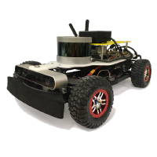
Agenda
01 Goals
02 Implementation and Design
03 Experiments and Results
04 Key Takeaways

Slide 3
Agenda
01 Goals
02 Implementation and Design
03 Experiments and Results
04 Key Takeaways

Slide 4
The goal was to implement accurate, safe, and robust algorithms
Wall Following
Safe, robust, accurate
Safety Controller
Reliable, quick acting
Notes:
May

Slide 5
Agenda
01 Goals
02 Implementation and Design
03 Experiments and Results
04 Key Takeaways

Slide 6
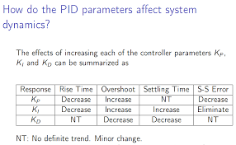
PD control dynamically handles errors and dampens oscillations
Diagram here about the PD and collected data from lecture
Maybe put some angles/which angles we sliced in order to create the line
Notes:
May

Slide 7
Translating our simulated wall following into the real world proved challenging
Getting acclimated with the robot pipeline
Robot hardware issues
Choosing whose code to use
Simulation accuracy didn’t translate 1:1 to real world
Notes:
Haley
Initial accuracy when first put into robot was …. Vs simulation accuracy
Some that were higher in sim were harder to translate to robot
Getting the code on the car itself (acclimated with the pipeline)
Deciding whose code to use
Accuracy in sim doesn’t match accuracy in the real life
Figuring out the units in sim vs in real life
Car didn’t work (hardware problems)
Simulation doesn’t translate very well
Kp and Kd values were different

Slide 8
Muxes allowed us to override signals and create a safety controller
Safety controller node
Continuously measures the nearest distance to an obstacle from each side using a ROS Node.
When a crash is imminent, publishes to the safety topic to override navigation:
front
left
right
/vesc/low_level/ackermann_cmd_mux/input/teleop
/vesc/low_level/ackermann_cmd_mux/input/safety
/vesc/low_level/ackermann_cmd_mux/input/navigation
priority
back
Notes:
Mo/Neil

Slide 9
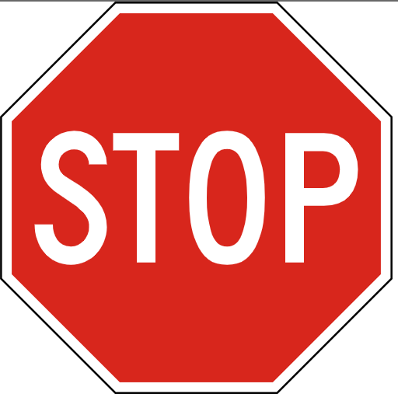
Controller stops when projected to run into an object at the front within 1 second, at the sides within 0.4 seconds
new signal
new signal
If the robot gets too close to an obstacle in the front AND its current velocity is directed forward THEN the safety controller sets its velocity to 0.
Notes:
Mo/Neil

Slide 10
Agenda
01 Goals
02 Implementation and Design
03 Experiments and Results
04 Key Takeaways

Slide 11
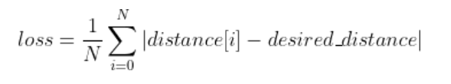
Average loss across all straight line cases was x%
Graphs of error relative to the desired distance of starting too far and too close to the wall
Notes:
Haley

Slide 12
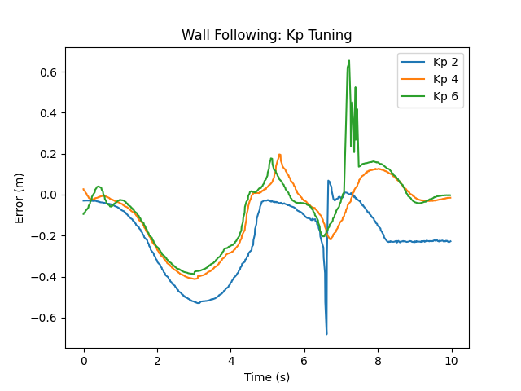
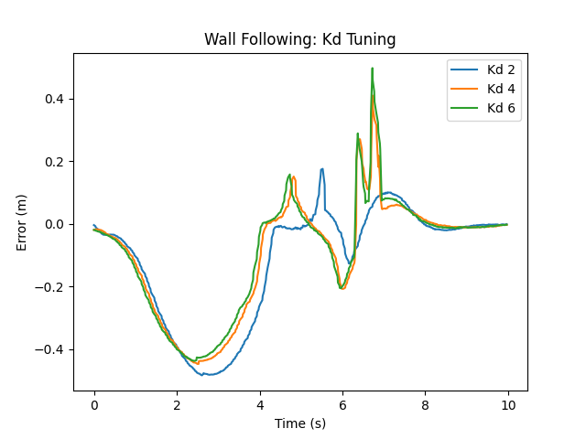
Tuning our Kp and Kd values allowed us to increase accuracy and study our system
The chosen Kp and Kd values of 4 and 2 led to a 0.1404 m absolute loss
Notes:
haley

Slide 13

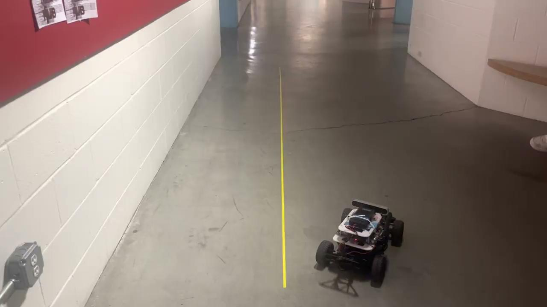
Average loss across all straight line cases was .036 meters
Notes:
Nikhil
Mention the objective use of the tape line

Slide 14
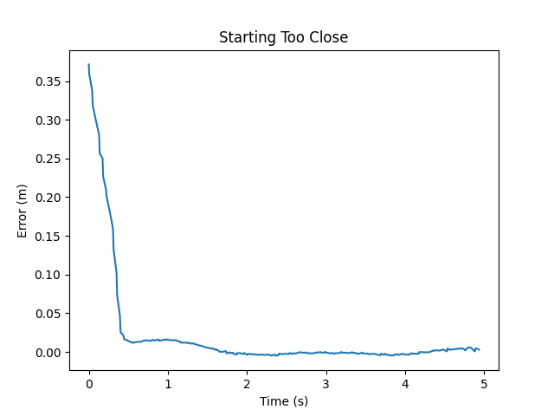
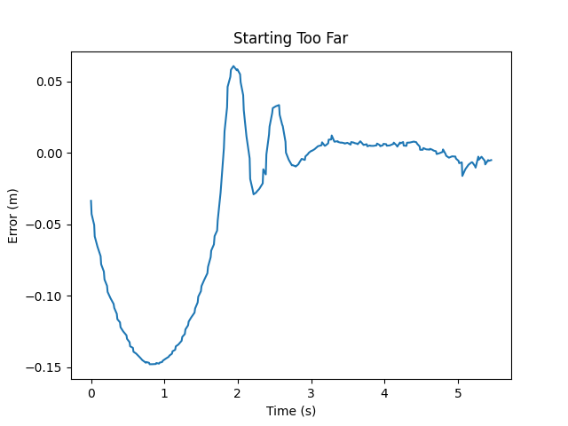
Average loss across all straight line cases was .036 meters
Notes:
Haley

Slide 15
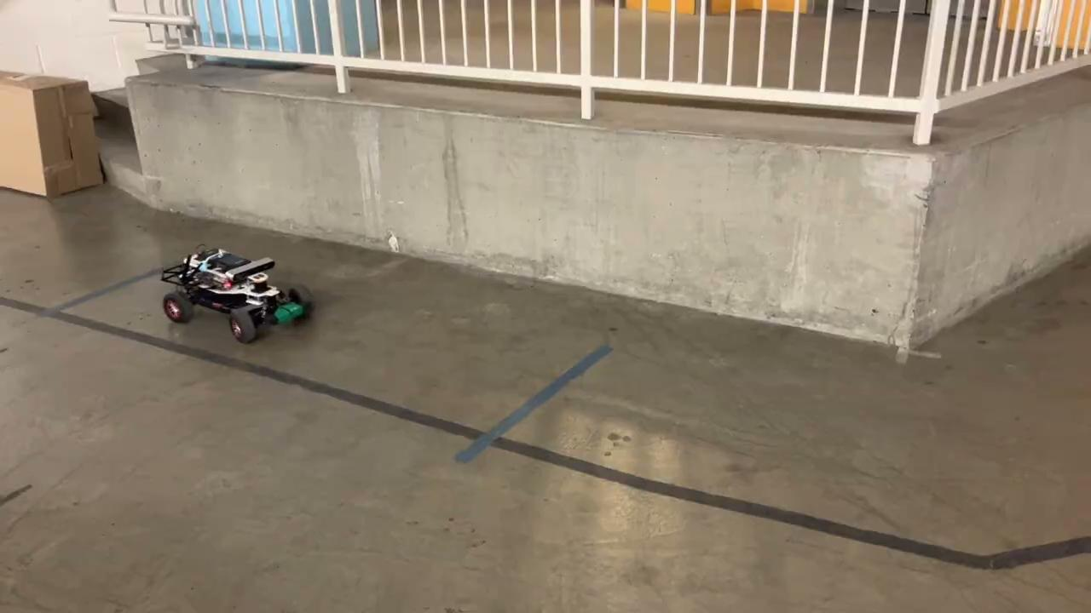
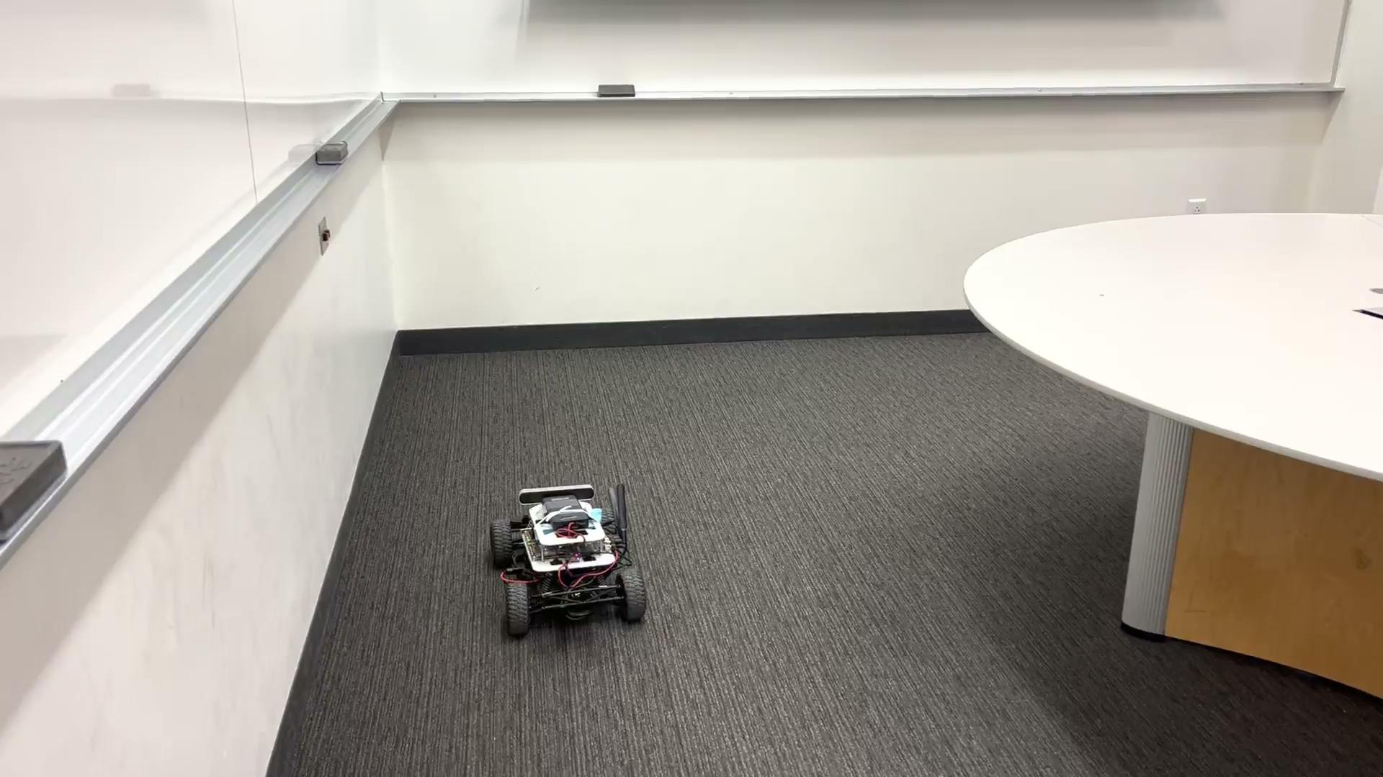
Our algorithm is resilient to changes in the direction of the wall
Notes:
Nihkil

Slide 16
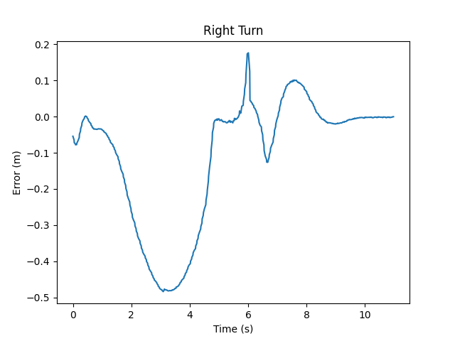
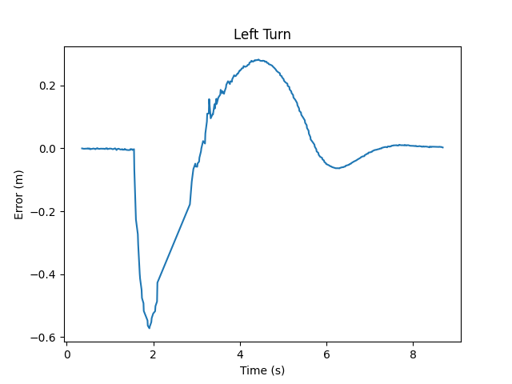
Our algorithm is resilient to changes in the direction of the wall
Notes:
Haley

Slide 17
0.071 meters
Avg loss achieved across all cases
Notes:
Nikhil
Can get loss by dividing avg loss by .75 (desired distance set at the time of the experiments)

Slide 18
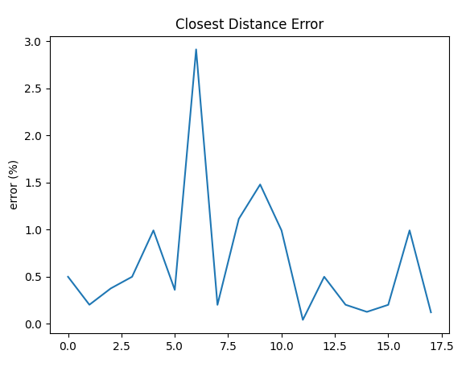
Our safety controller computes the closest distance with 0.6% accuracy
Mean error: 0.6%
Notes:
Mo

Slide 19
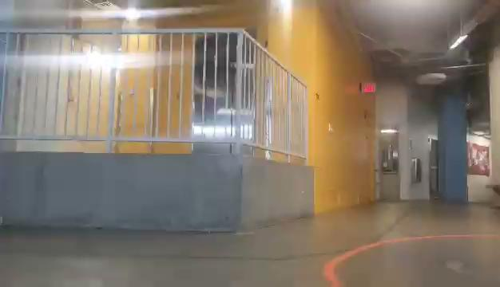
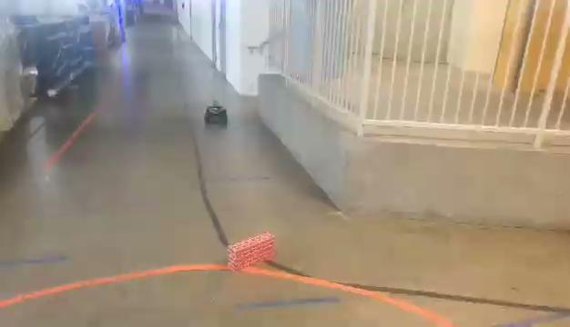
Our safety controller reacts to both sudden and static obstacles
Notes:
Mo

Slide 20
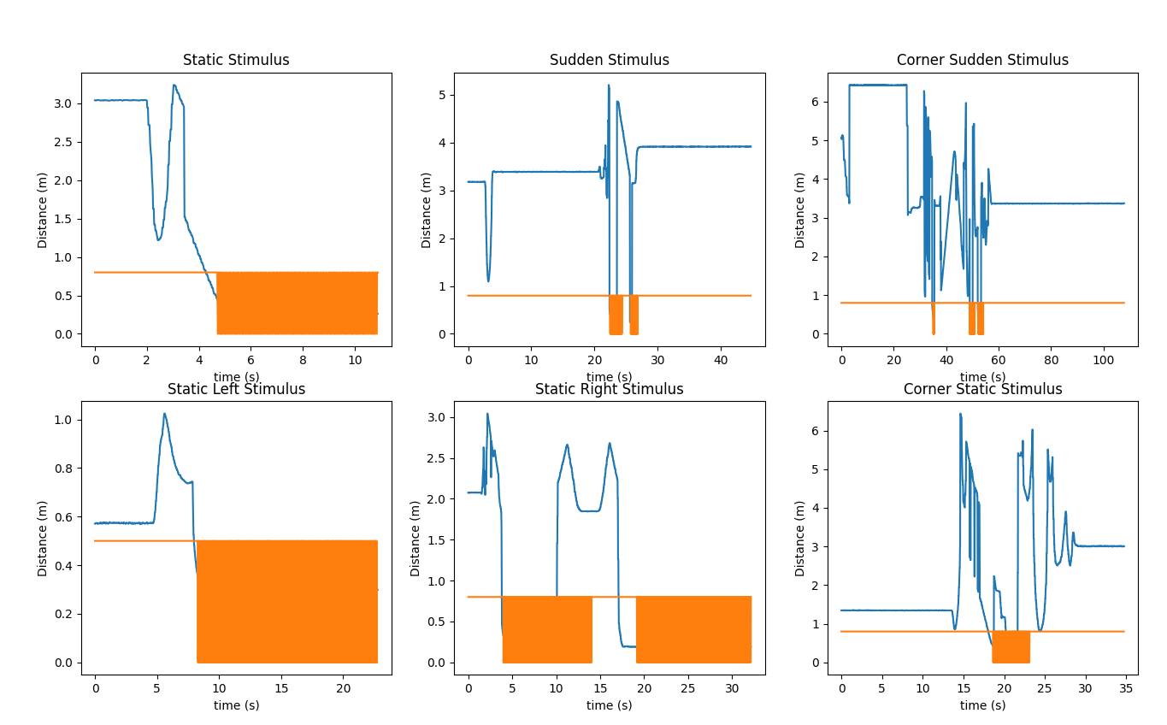
Safety Controller decreased risks while performing tasks with the robot
Notes:
Neil

Slide 21
Agenda
01 Goals
02 Implementation and Design
03 Experiments and Results
04 Key Takeaways

Slide 22
Completing our first team assignment taught us a variety of lessons
The best models in simulation may not work in the real world
Spending time to define and delegate tasks makes the team more efficient and allows us to budget robot time
Organizing files and recording commands allows for faster communication within the team
Notes:
May

Slide 23
Our Wall Follower and Safety Controller are both accurate, robust, and reliable
Our wall follower achieved an average loss of .071 meters
Utilized LIDAR scanning and PD control
Robust to different changes in the wall and location
Our safety controller was robust and secure
Achieved X reaction time to stimulus
Able to react to both static and sudden obstacles
Notes:
Nikhil

